Slide 1
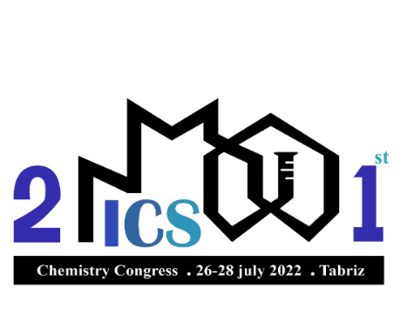
St
ICS
21st ICS International Chemistry Congress
International
Chemistry
Title
A^{1*}, B², C³
^{1,2,3}Chemistry Department, Faculty of Science, Azarbaijan Shahid Madani University, Tabriz, Iran
Email*:
Congress
Azarbaijan Shahid Madani University
Introduction
Add Text here........
Experimental
Add Text here........
Conclusion
Result and Discussion
Add Text here........
Add Text and photos here........
References
Add Text here........
References should be written according to below sample
[1] M. Babaei, H. Eshghi, Kh. Abnous, M. Rahimizadeh, M. Ramezani, Cancer Gene Therapy, 2017, 24, 156.
[2] J.W. Steed, J.L. Atwood, Supramolecular Chemistry. 2nd Edition ed., John Wiley & Sons, Ltd: 2009.

